Slide 1
ACT Math Prep

Slide 2
Before we start
Get a good night’s rest. Eat what you always eat for breakfast.
Use the test booklet for scratch paper. You can’t bring your own.
Remember your formulas. You will not get them on the test.
Turn word problems into equations or equations into word problems -- whichever is easiest for you!
You can use a calculator.
Don’t be afraid! Self-doubt lowers scores.
Hard questions vs. easy questions
  Must answer all easy questions
  Go back and guess on hard ones if you run out of time
One minute per question
  Faster on easy questions
  Skip questions that take too much time
  Guess if you run out of time

Slide 3
60 questions in 60 minutes
Content | Percent of Test | Number of Questions
Pre-Algebra | 23% | 14
Elementary Algebra | 17% | 10
Intermediate Algebra | 15% | 9
Coordinate Geometry | 15% | 9
Plane Geometry | 23% | 14
Trigonometry | 7% | 4
TOTAL | 100% | 60
Scores reported:
Total Mathematics Test score based on all 60 questions.
Pre-Alegebra/Elementary Algebra Subscore
Intermediate Algebra/Coordinate Geometry Subscore
Plane Geometry/Trigonometry Subscore
Source: The Real ACT Prep Guide. ACT. 2nd Ed.

Slide 4
Pre-Algebra
Operations using whole numbers, fractions, and decimals.
  PEMDAS
  2x3= ?
  4/2 x 6/2= ?
  1/5 x .5 = ?
  4/.5 = ?
Numbers raised to powers and square roots.
  2²
  4^{.5}
Simple linear equations with one variable.
  3x+7=16. Solve for X.
Simple probability and counting the number of ways something can happen.
  On a six sided die, what are the chances of rolling a five?

Slide 5
Pre-Algebra
Ratio, proportion, and percent.
  3 is what percent of 6? What is 50% of 6?
Absolute value.
  What is the absolute value of -3?
  |-3| = ?
Ordering numbers from least to greatest.
Reading information from charts and graphs.
Simple stats
  Mean: add all terms together and divide by number of terms.
  Median: order terms from lowest to highest. Eliminate high and low terms till you’ve reached the middle. If two terms are left, take the mean.
  Mode: most frequent term.

Slide 6
Elementary algebra
Substituting the value of a variable in an expression.
  Add like terms. Separate different terms.
  2x+2x+7y=15.
  Y=2. Solve for X.
Performing basic operations on polynomials and factoring polynomials.
  FOIL
  (x-3)(x+7) = ?
  x²+8x+12=0. Solve for X.
  Factor x²-11+30.
Solving linear inequalities with one variable.
  X+7<12. What do we know about x?
  X+6>19 and x-8<6. What do we know about x?

Slide 7
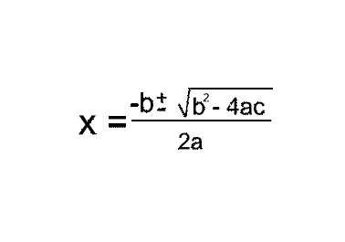
Intermediate algebra
Quadratic Formula
  When you can’t factor a polynomial cleanly. You can always use the quadratic formula
  In x²+7x+15=0, what is a, b, and c?

Slide 8
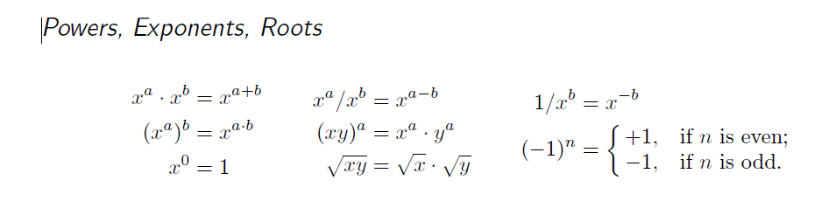
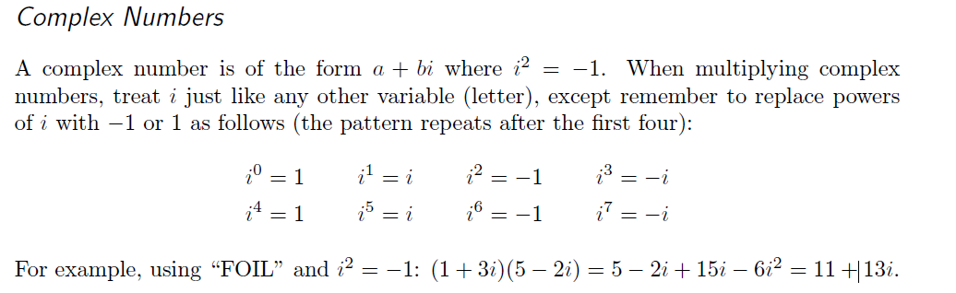
Intermediate algebra
  \
Source: http://www.erikthered.com/tutor/act-facts-and-formulas.pdf

Slide 9
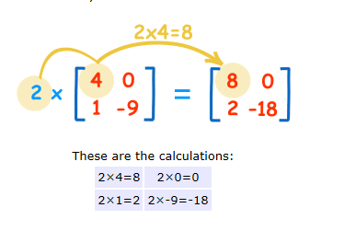
Intermediate algebra
What are the dimensions of a matrix?
  Up and over.
Multiplying Matrices
  Scalar multiplication
  A number times everything inside the matrix.
Source: http://www.mathsisfun.com/algebra/matrix-multiplying.html

Slide 10
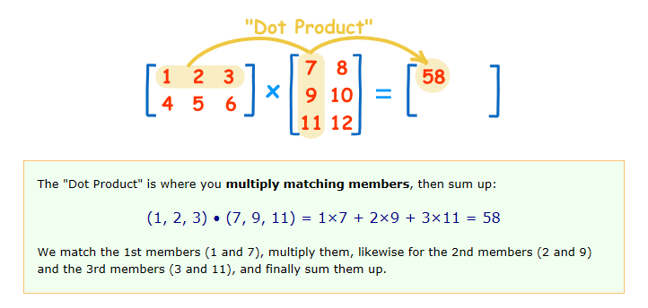
Intermediate algebra
Multiplying a matrix by another matrix
  2x3 * 3x2.
  Can we do it?
  What will the final matrix look like?
Source: http://www.mathsisfun.com/algebra/matrix-multiplying.html

Slide 11
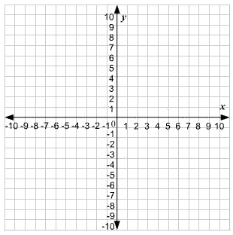
Coordinate geometry
Graphs of lines, curves, points, polynomials, circles in an (x,y) plane.
Relationship between equations and graphs, slope, parallel and perpendicular lines, distance, midpoints, transformations, and conics.
It’s coordinate, so draw it on the graph!

Slide 12
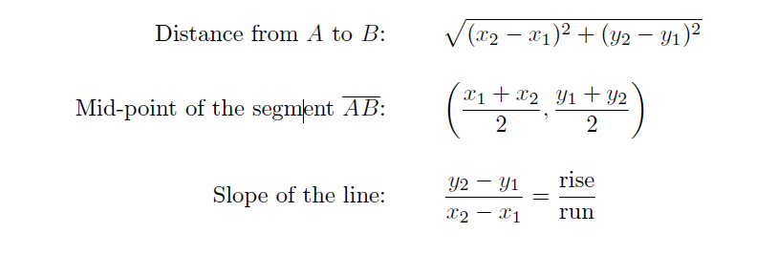
Coordinate geometry
Lines
  A line goes through points A(2, 3) and B(4, 5). You should be able to find the following:
  Parallel lines have the same slope. Perpendicular lines have inverted slopes.
Source: http://www.erikthered.com/tutor/act-facts-and-formulas.pdf

Slide 13
Plane geometry
Relations and properties of shapes (triangles, rectangles, parallelograms, trapezoids, and circles), angles, parallel lines, and perpendicular lines.
What happens when you move or change these shapes?
  Translations, rotations, reflections
Proofs
  Justification, logic.
Three-dimensional geometry
Measurements: perimeter, area, and volume.

Slide 14
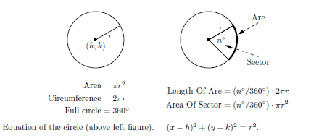
Plane geometry
Circles
Source: http://www.erikthered.com/tutor/act-facts-and-formulas.pdf

Slide 15
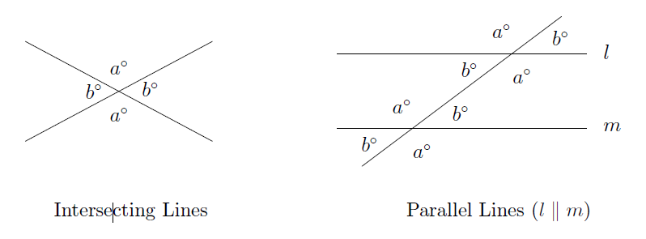
Plane geometry
Lines in a plane
What do we know about a and b in both of these cases?
Source: http://www.erikthered.com/tutor/act-facts-and-formulas.pdf

Slide 16
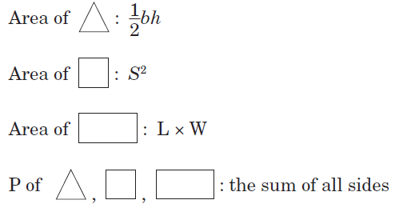
Plane geometry
Other shape areas and perimeters.
If an angle is greater than 90, it is obtuse.
If an angle is less than 90, it is acute.
If an angle is 90, it is a right angle.
TRIANGLE: SUM OF ALL ANGLES = 180
SQUARE AND RECTANGLE: SUM OF ALL ANGLES = 360
Source: http://www.erikthered.com/tutor/act-facts-and-formulas.pdf

Slide 17
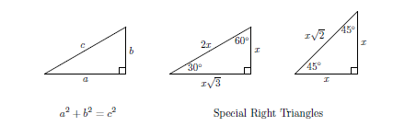
Plane geometry
Right Triangles
    How do you find the length of a side in a right triangle? Pythagorean Theorem.
Other Triangles: Equilateral (all three sides are equal), Isosceles (two equal sides), and Similar (corresponding angles are equal and sides are in proportion).
Source: http://www.erikthered.com/tutor/act-facts-and-formulas.pdf

Slide 18
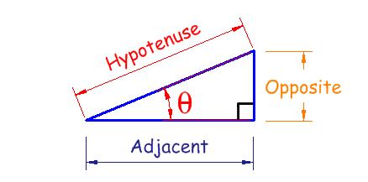
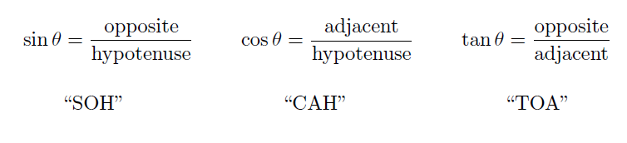
Trigonometry
Trigonometric functions for right triangles:
  SINE
  COSINE
  TANGENT
Source: http://www.mathsisfun.com
Source: http://www.erikthered.com/tutor/act-facts-and-formulas.pdf

Slide 19
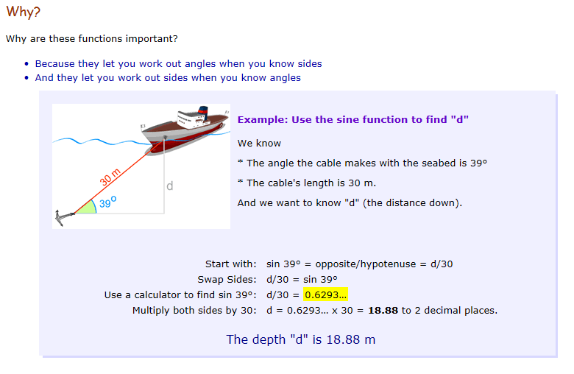
Trigonometry
Source: http://www.mathsisfun.com

Slide 20
trigonometry
Source: http://www.mathsisfun.com

Slide 21
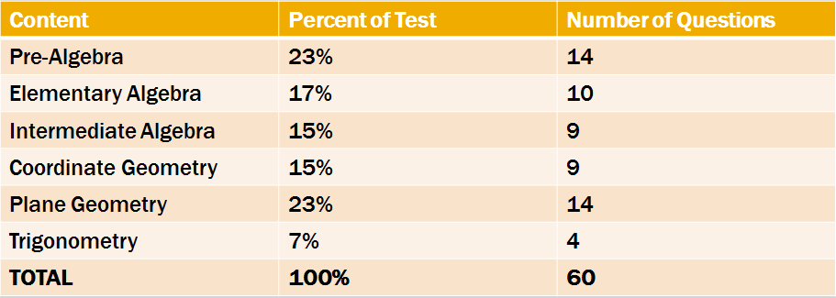
Don’t be overwhelmed!
Source: The Real ACT Prep Guide. ACT. 2nd Ed.

